Slide 1
Domain server
Using dns zones….

Slide 2
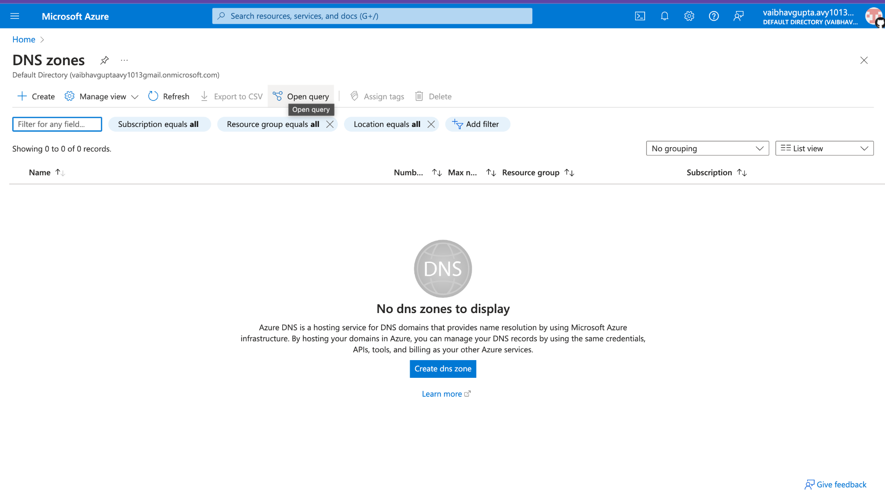
Create a dns zone

Slide 3
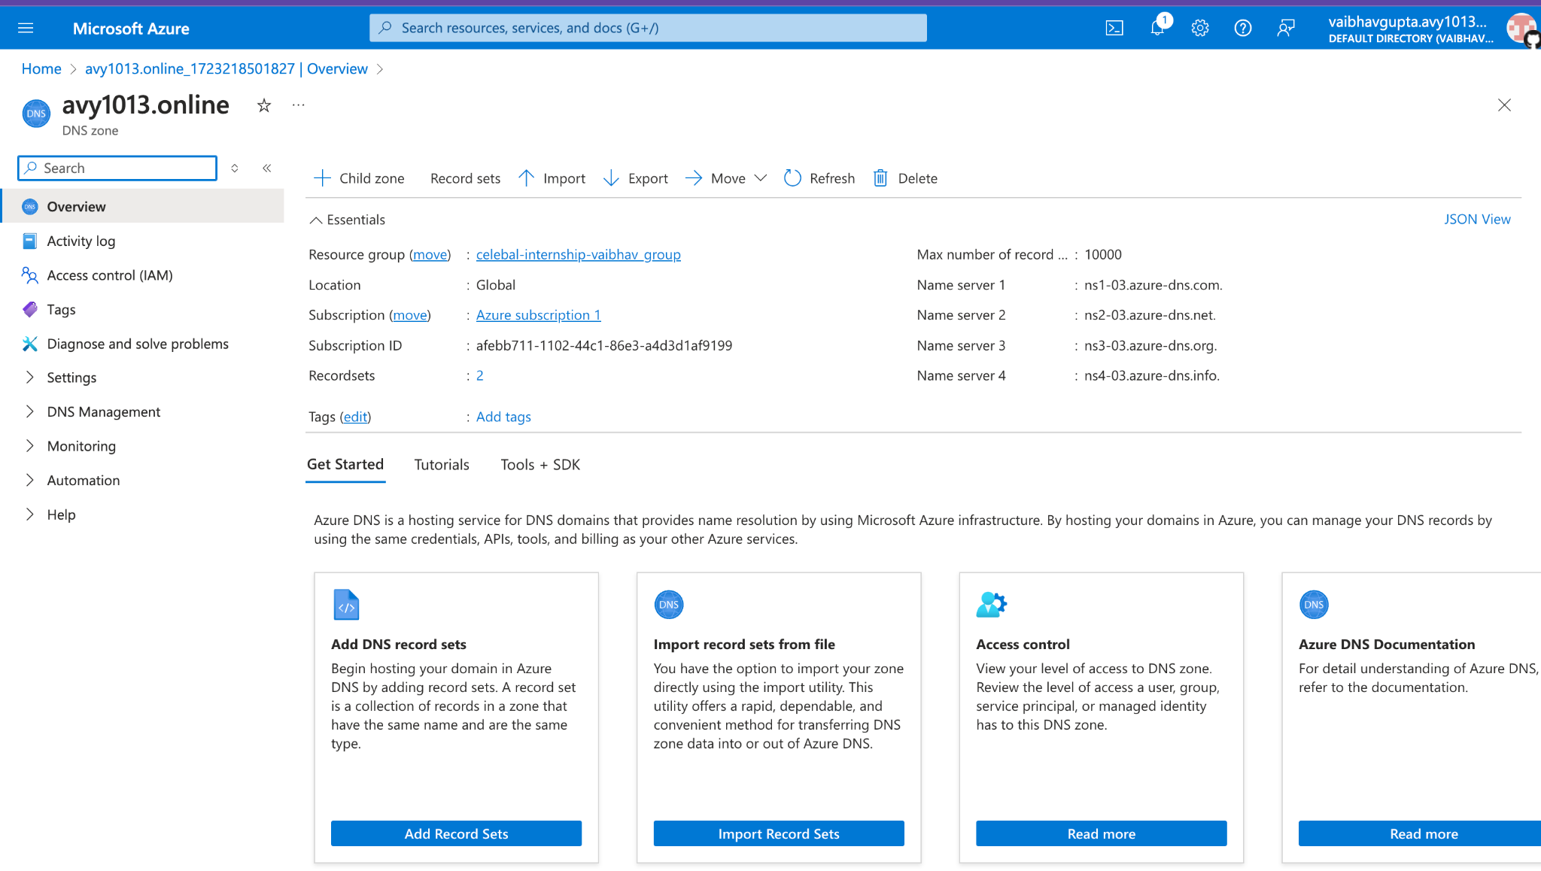
Deploying a dns zone

Slide 4
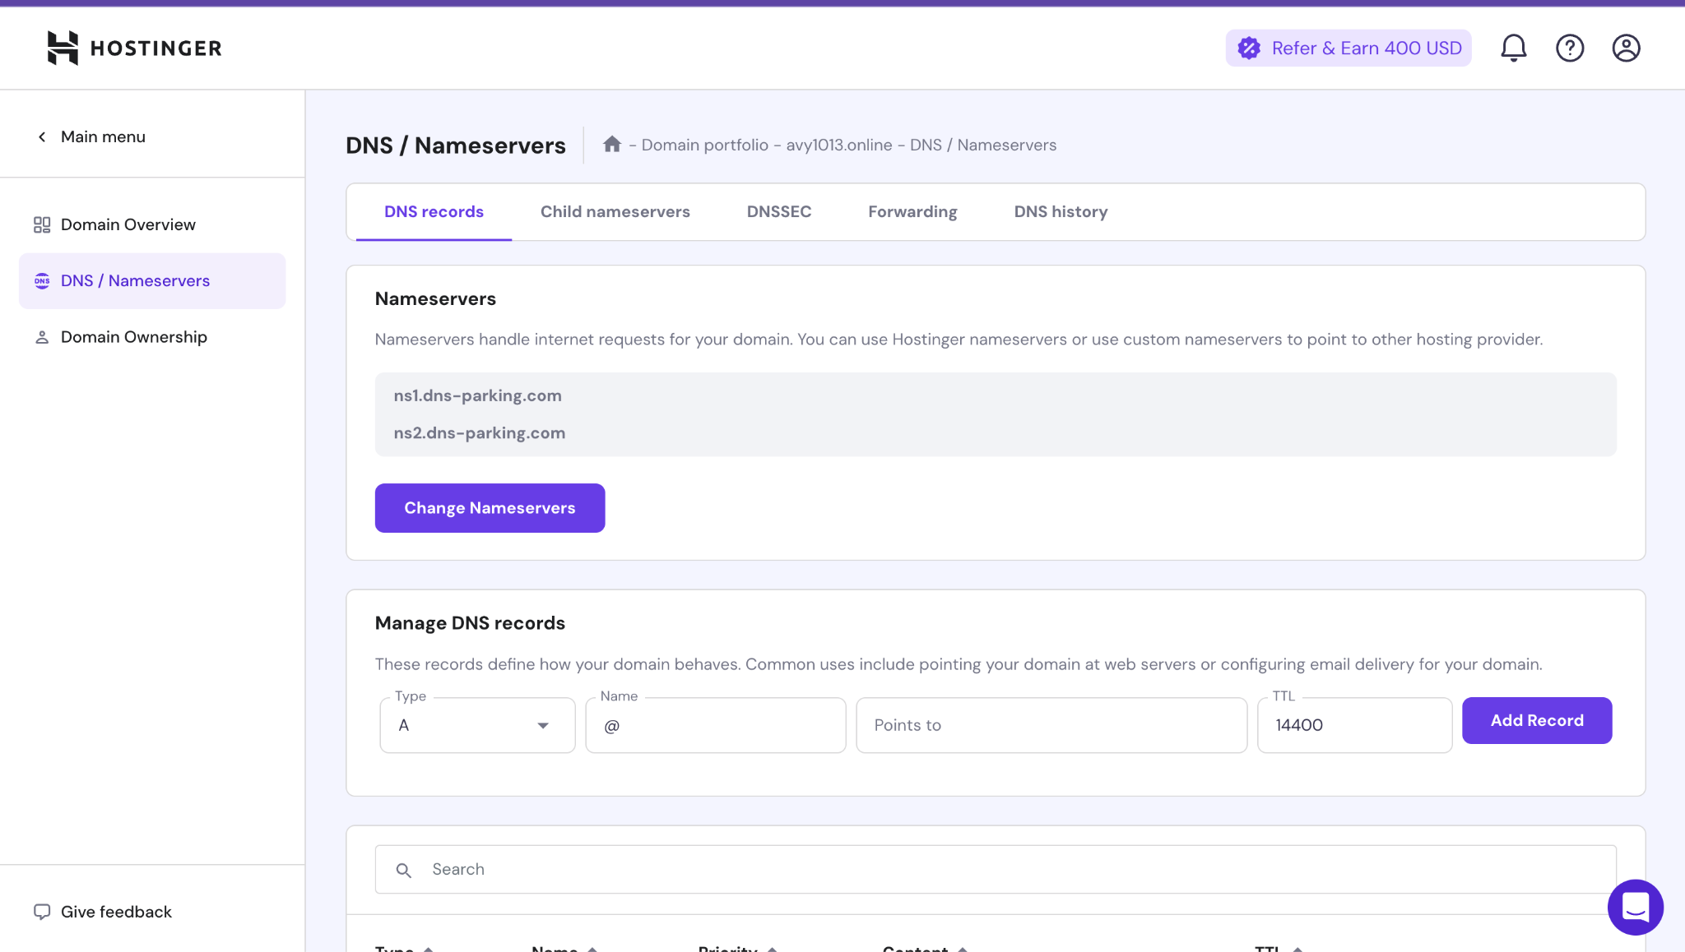
Add nameservers from dns zone

Slide 5
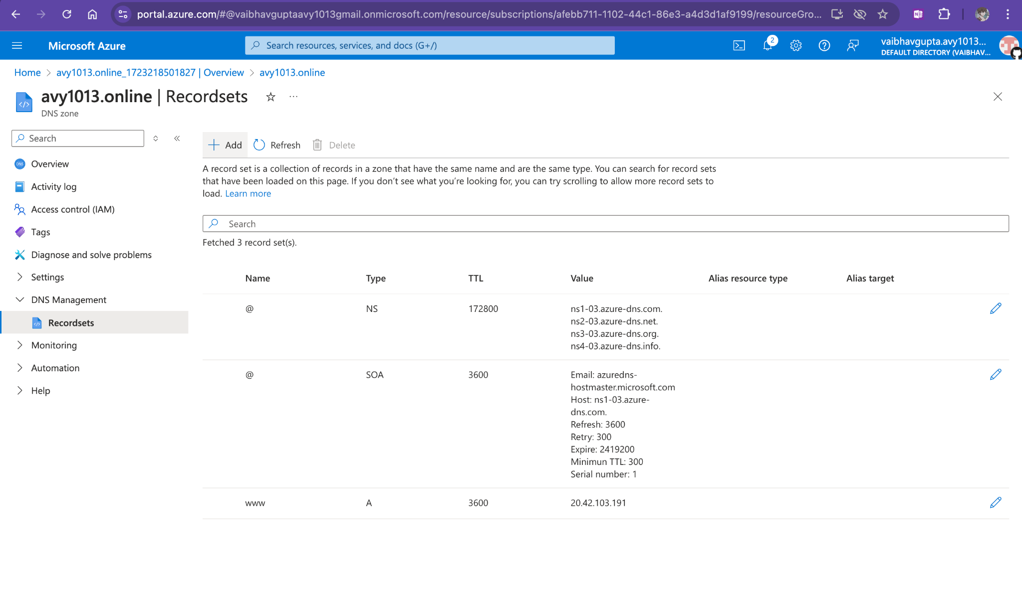
Add record in dns

Slide 6
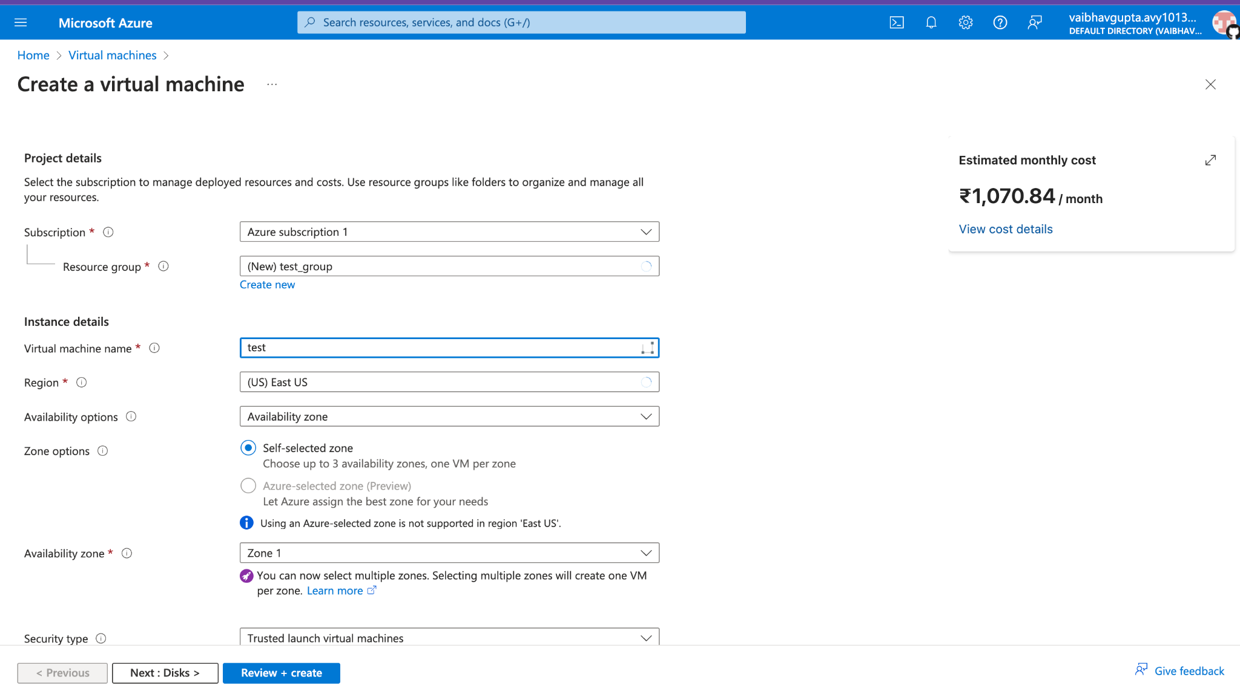
Create a server/vm

Slide 7
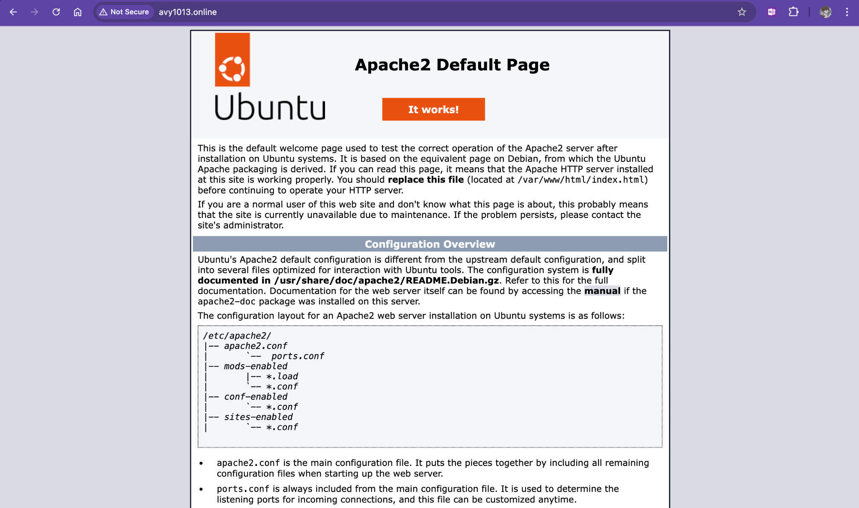
IT WORKS ON CUSTOM DOMAIN

